Slide 1
Comfortable Wheelchair Navigation for SCI
Patients through Automated Surface Classification
IEEE International Conference on Digital Health 2021
Huy Tran Quang, Reetik Chandra, Tuong Anh Nguyen, Vaskar Raychoudhury
Dept. of Computer Science & Software Engineering
Miami University

Slide 2




Our Team
Huy Tran Quang
Reetik Chandra
Tuong Anh Nguyen
Vaskar Raychoudhury

Slide 3
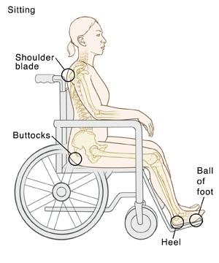
Motivation
~296,000 people living with Spinal cord injuries (SCI) in the US.
~17,900 new SCI cases each year increases wheelchair users.
Most people with an SCI use a wheelchair at some point.
Having an SCI may cause patients to develop conditions like pressure injuries from contact with wheelchair. [1]
Fig. Spinal Cord Injury (SCI) and Pressure Injuries from fairview.org
[1] “Spinal Cord Injury (SCI) and Pressure Injuries,” Fairview. [Online]. Available: https://www.fairview.org/patient-education/41153. [Accessed: 04-Sep-2021].
Notes:
SCI definition and how it relates to wheelchair. Some deduction we could have from that.

Slide 4

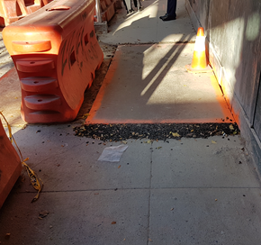
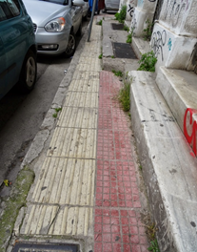

Motivation
Vibrations generated by wheelchair are often uncomfortable or even painful on surfaces like cobbles.
Uneven surfaces on roads and sidewalks are often not accessible for wheelchair users.
Research Question: Can we find a comfort index (CI) of various types of surfaces for SCI users on wheelchairs?
Fig: Examples of various barriers to wheeled mobility (stairs, construction zone, narrow sidewalk, steep slope)
Notes:
SCI definition and how it relates to wheelchair

Slide 5
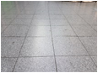



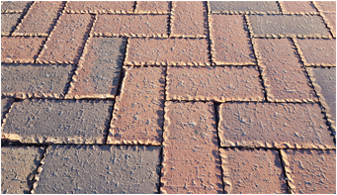

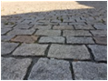


How Comfort Index Varies Across Surfaces?
Indoor smooth tile
Indoor linoleum
Indoor carpet (low-pile)
Outdoor concrete sidewalk
Outdoor asphalt
Outdoor paver-block sidewalk
Outdoor cobbled road (smooth and small gaps)
Outdoor cobbled road (rough and large gaps)
Outdoor grass
Outdoor gravel
Outdoor sand
How the accessibility and comfort index varies from 1 to 11

Slide 6
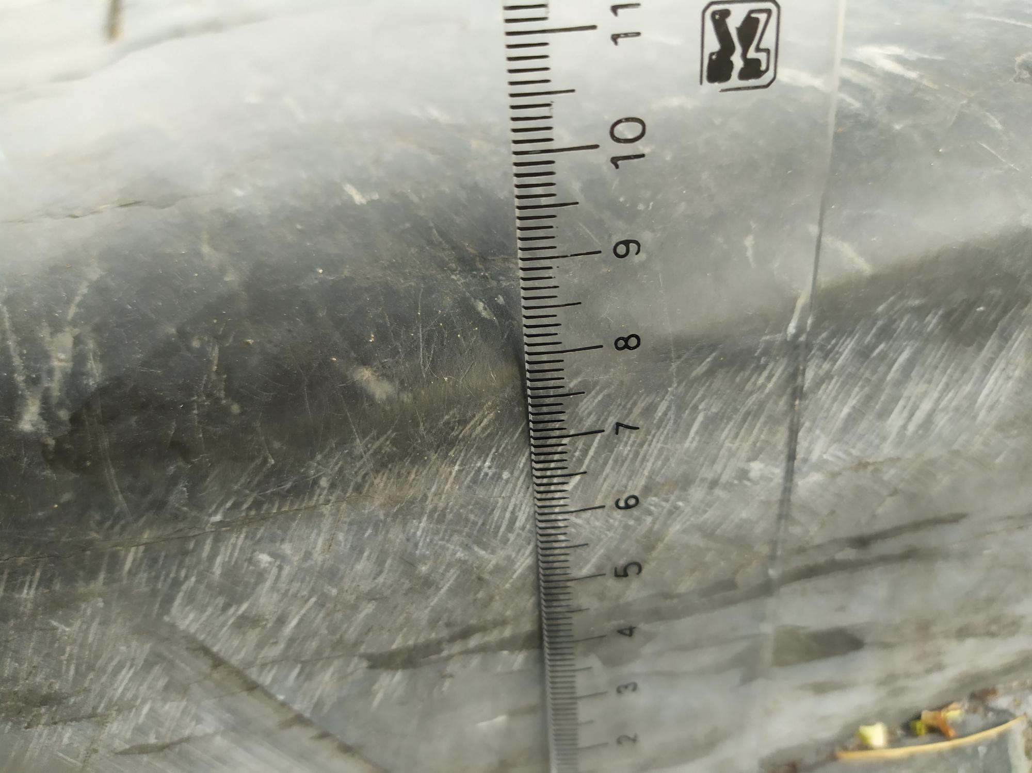
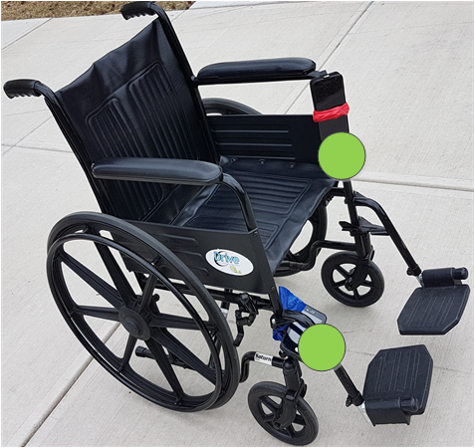
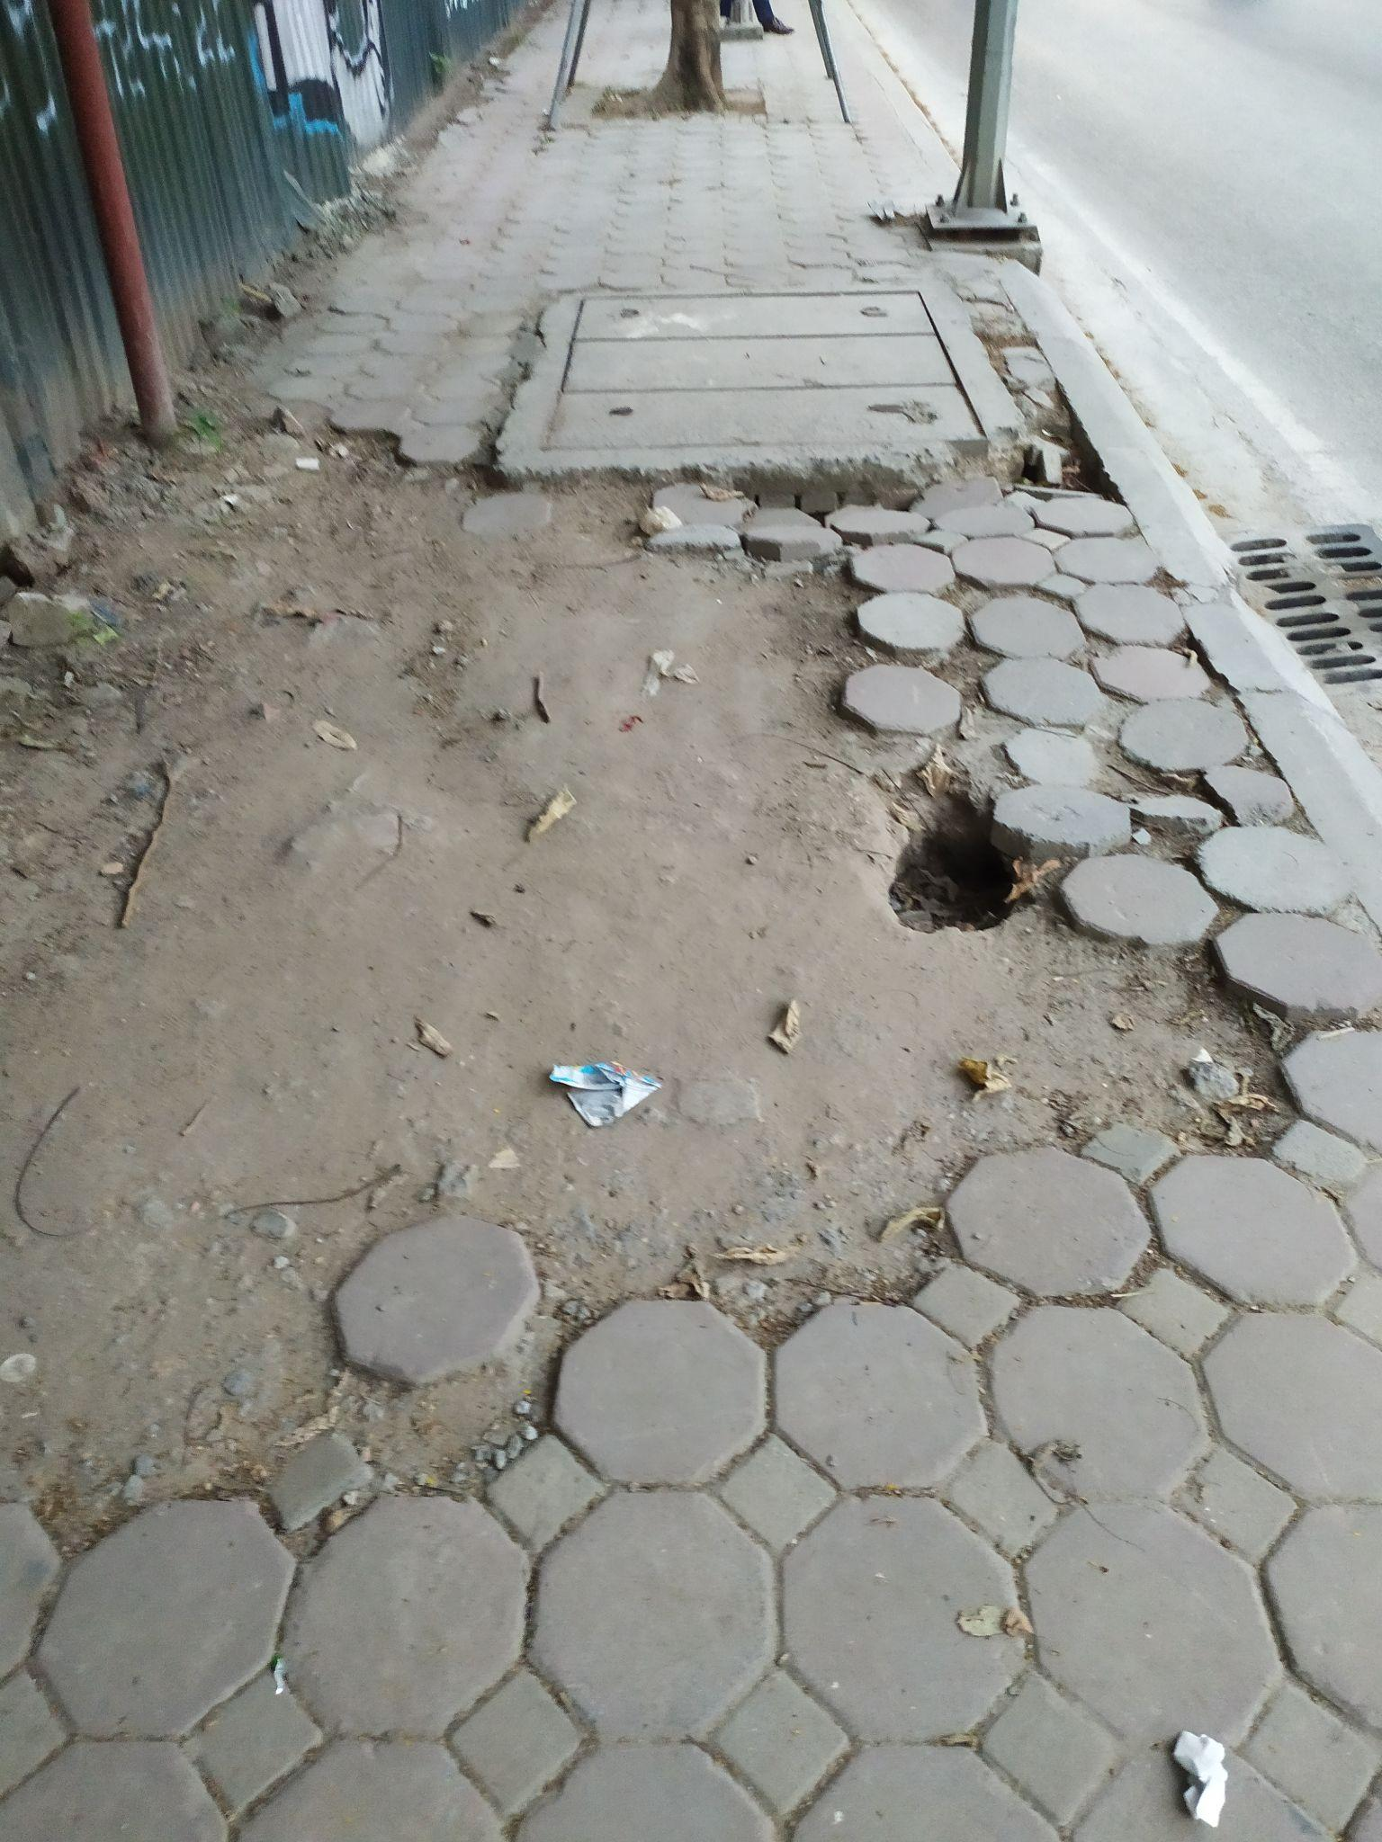
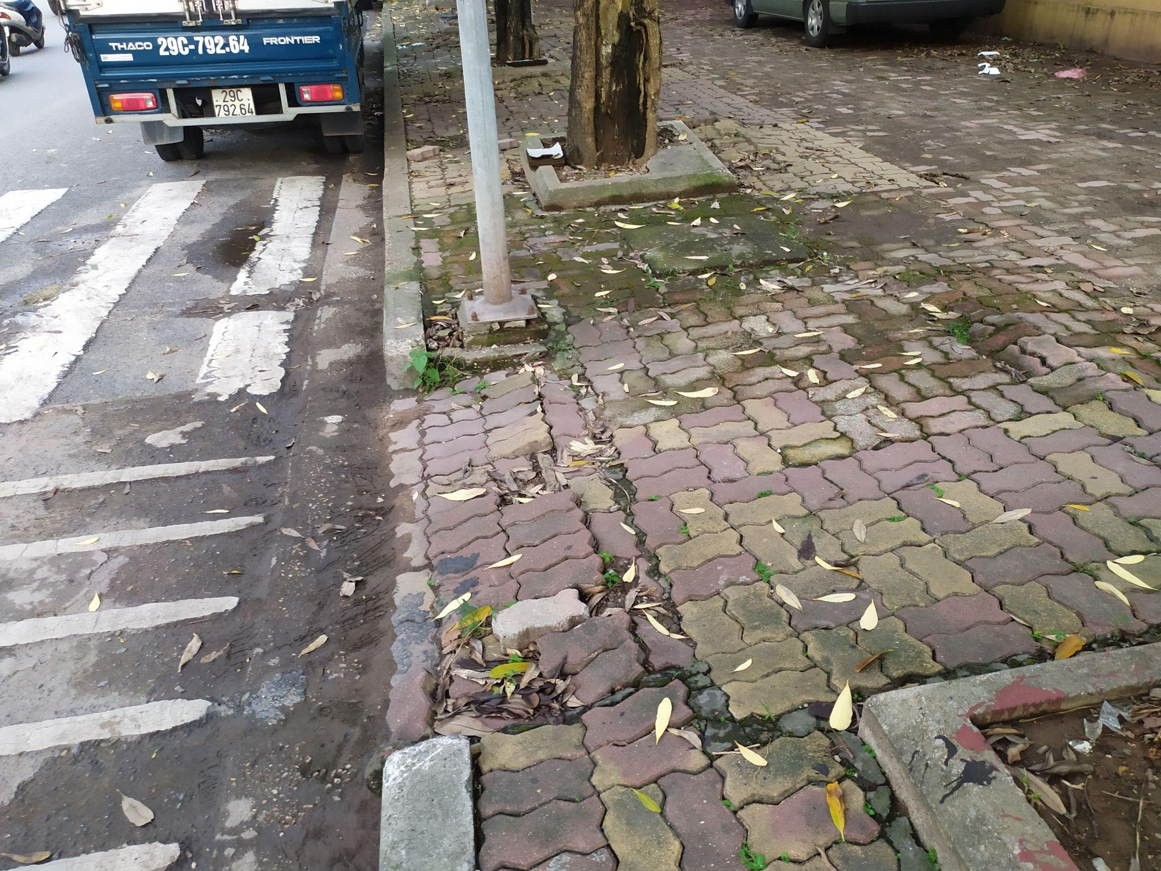

Data Collection
We have started data collection in Ha Noi, Vietnam.
Using a manual wheelchair and multiple participants of different age group.
Fig: Barriers observed in Ha Noi during data collection
Notes:
Some data we have collected throughout the summer 2021. We are planning to present the preliminary results of this paper.

Slide 7
Goal
Finding a comfort index of various
types of surfaces for SCI users on wheelchairs.
Comfort Index (CI) is a quantitative way of capturing the navigability of a particular surface.
End-goal: Surfaces’ comfort indices will be used to determine end-to-end accessible routes for wheelchair users with spinal cord injuries.
Notes:
Building a Path Knowledgebase
Collecting (in)/accessible path features in a central large-scale repository
Determining Accessibility of Surfaces
Rapid, accurate and objective identification

Slide 8
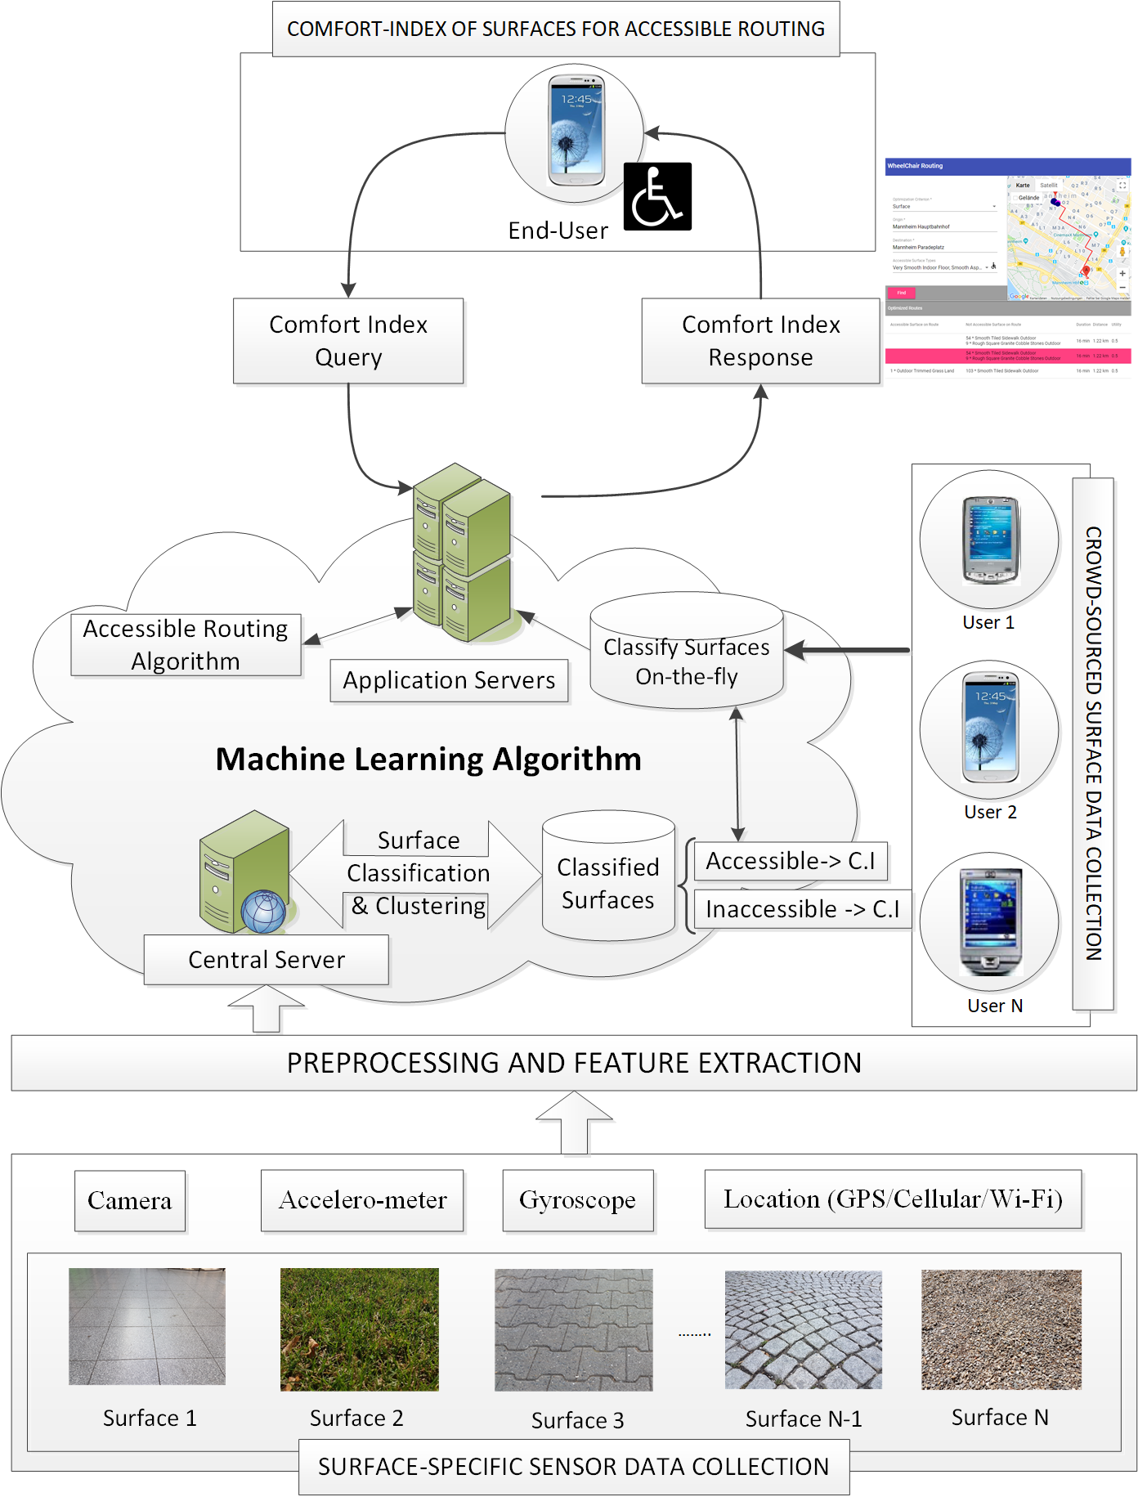
Proposed System Architecture
Our system captures user information and process it through machine learning to classify different types of surfaces
We calculate comfort index of each type of surface using a novel quantitative method
Our system can then generate most accessible end-to-end routes for wheelchair users with SCI
Notes:
By using the app, the users also contributes their data (GPS, accelerometer, CI query, etc) to the system (servers)
=> The ML algorithms then are further improved and generate better routing scheme in the future.

Slide 9
Thank you!
For more updates please see our site: http://www.routemypath.com
Notes:
Summary

